Slide 1
Investigation of CryptoWall Ransomware — PCAP analysis (2015-07-24)
Piyush K Karn (252IS026) | Samyak Gedam (252IS032)

Slide 2
Broad Overview
Scenario: On July 24, 2015, a network analyst detected CryptoWall-related Snort alerts from an internal host. A PCAP was captured to investigate the infection source and confirm exploit kit involvement.
Problem Statement: A Windows host showed unusual HTTP traffic after visiting a legitimate site. The PCAP (2015-07-24-traffic-analysis-exercise.pcap) is analyzed using Zeek and Wireshark to identify the infected host, trace the infection chain, and reveal the malware, exploit kit, and C2 infrastructure.
Roles:
Zeek: Log parsing, timeline, IOCs, file metadata.
Wireshark: Packet validation, payload extraction, stream analysis.

Slide 3
Outline & Goals
Identify the infected host – uncover its hostname, IP, and digital footprint in the network.
Trace the infection vector – determine which exploit kit delivered the malware.
Reveal the landing site – find the legitimate website that led to the compromise.
Map post-infection activity – discover C2 domains, IPs, and other malicious infrastructure.
Extract payloads – recover any transferred malware samples or artifacts from the PCAP.
Correlate indicators of compromise (IOCs) – build a clear timeline and confirm CryptoWall behavior.

Slide 4
Prepare / run Zeek
Commands to run:
# run Zeek on pcap
zeek -C -r 2015-07-24-traffic-analysis-exercise.pcap
# list logs
ls -lh logs/current
Notes:
Speaker notes: Explain -C flag, and that Zeek writes conn.log, dns.log, http.log, dhcp.log, files.log, notice.log, etc.

Slide 5
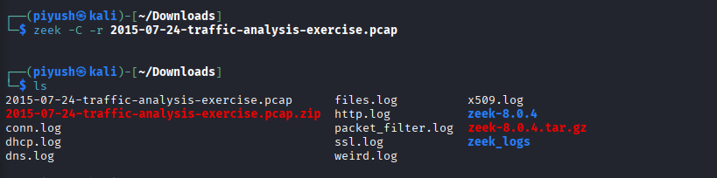
Zeek reads the entire PCAP and produces logs including:
conn.log — every TCP/UDP/ICMP connection
dns.log — all DNS transactions
http.log — all http requests/responses
files.log — files seen
dhcp.log — DHCP messages
Notes:
Run zeek on pcap file and generate logs

Slide 6
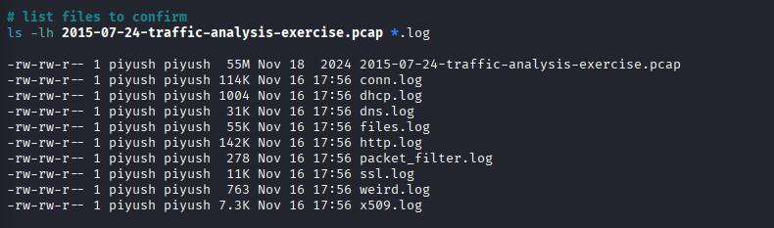
Notes:
List of files to confirm

Slide 7
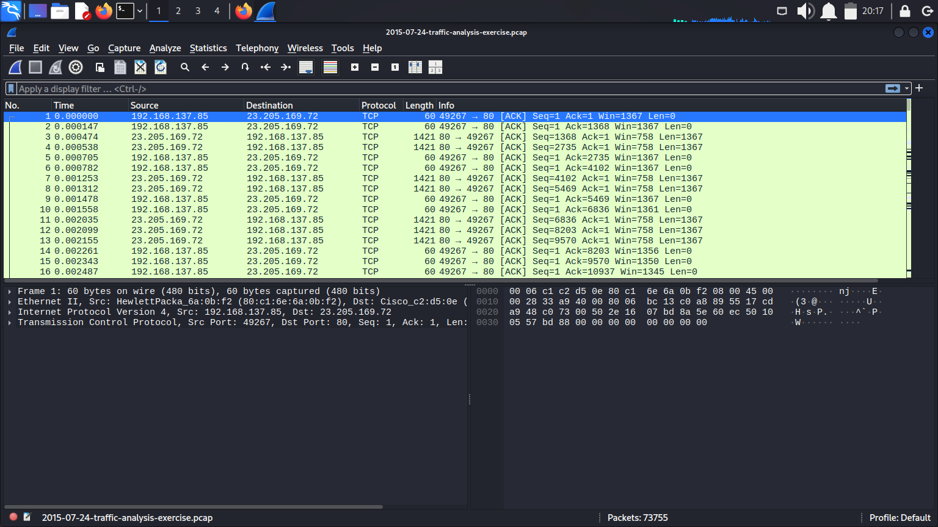
Wireshark view of the PCAP file

Slide 8
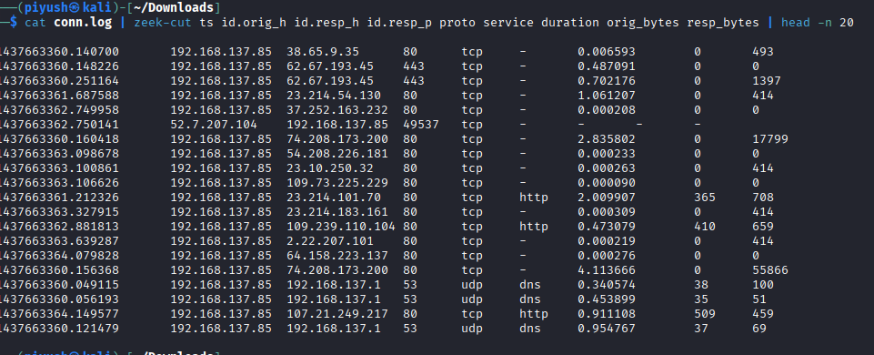
Metadata & Description of the PCAP file
Notes:
metadata

Slide 9
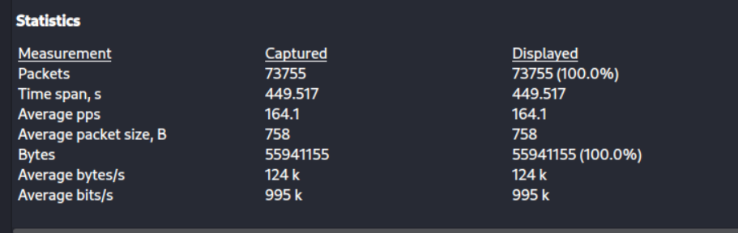
The capture contains 73755 packets collected over a duration of approximately 7 minutes and 50 seconds. The average packet rate is around 124k bytes packets per second. The link-layer type is Ethernet. This suggests a moderate amount of web browsing and background communication.
Notes:
PCAP Details Using Capture File Properties

Slide 10
Phase 1: Identifying the Hosts Involved
The aim of this step is to identify:
The internal device (likely the victim machine)
All external IP addresses it communicates with
Any abnormal or suspicious connections
This helps establish the communication map before deeper malware analysis.

Slide 11
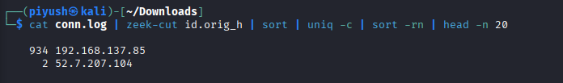
Find infected host IP & top talker
# Top source IPs by connection count
cat logs/current/conn.log | zeek-cut id.orig_h | sort | uniq -c | sort -rn | head -n 10
192.168.137.85 is the internal infected host
Notes:
Speaker notes: Show that 192.168.137.85 is the internal infected host (matches exercise). Use this to explain you will focus on flows from that host.

Slide 12
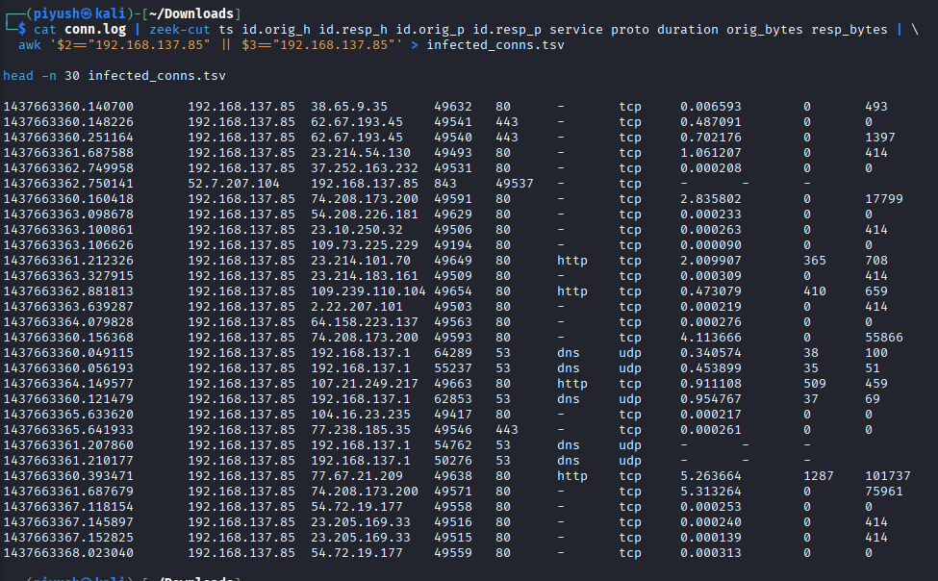
Infected_conns
Notes:
Infected conns

Slide 13
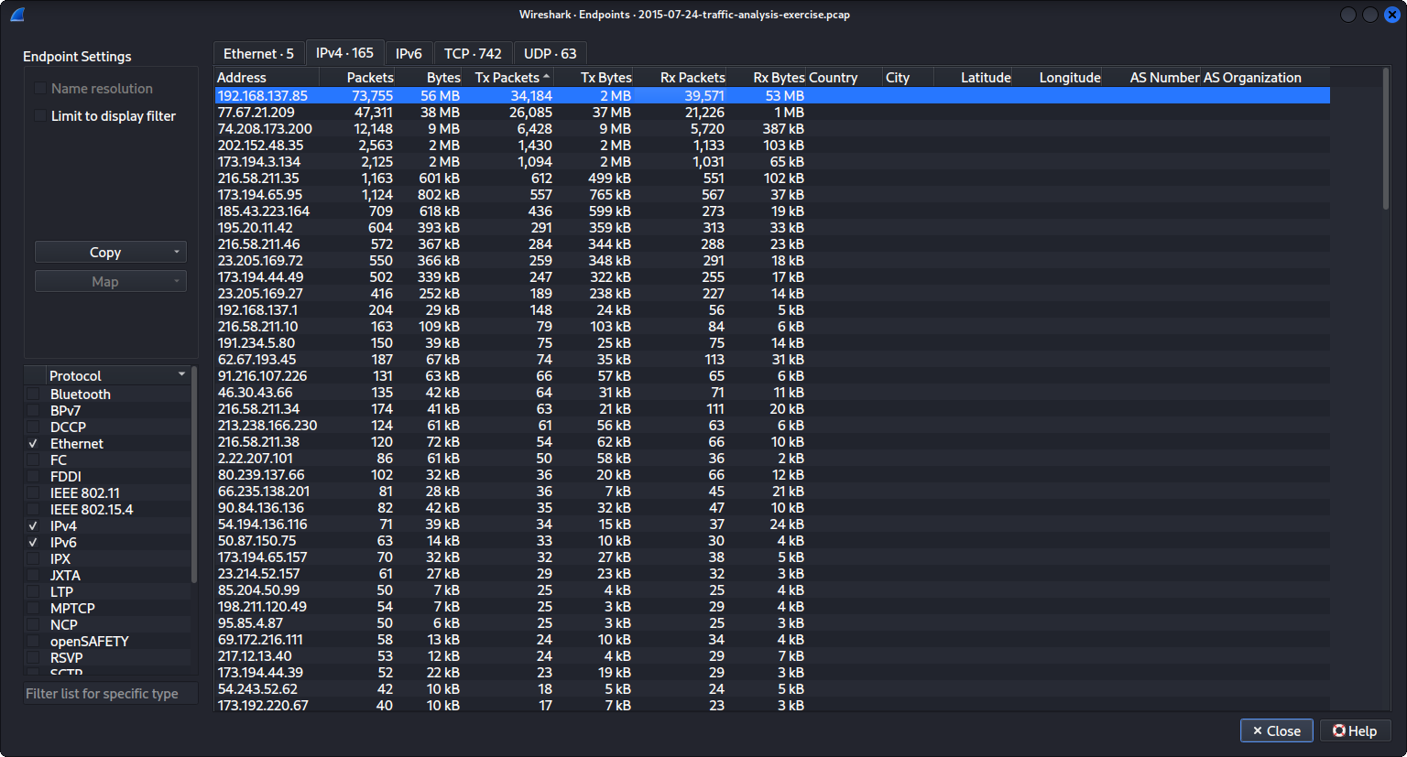
The Conversations window sorted by Bytes, highlighting 192.168.137.85 as the top talker.
Notes:
The Conversations window sorted by Bytes, highlighting 192.168.137.85 as the top talker.

Slide 14
The IP address 192.168.137.85 has:
73,755 total packets
56 MB transmitted
53 MB received
This is much higher than any other address in the list, clearly indicating that:
192.168.137.85 is the victim workstation
(It is a private IP address and dominates traffic volume.)
This will be the primary focus for further DNS and HTTP analysis.

Slide 15
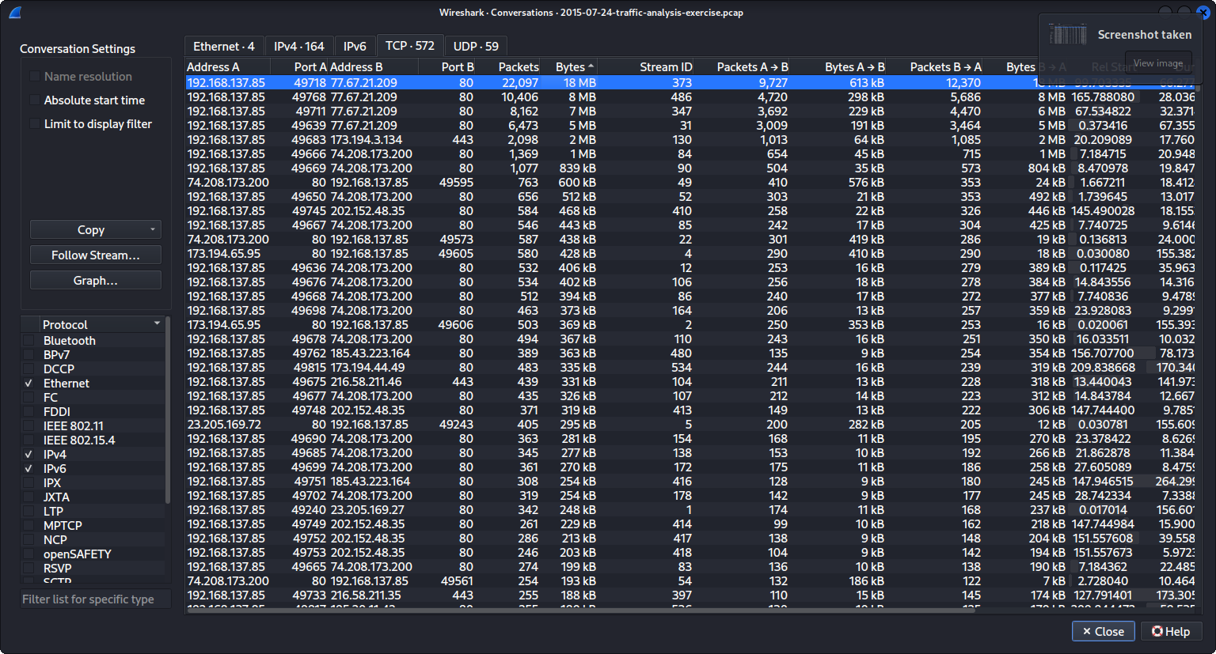
Conversations (TCP Tab) — Victim IP (192.168.137.85) and Most suspicious external IPs (77.67.21.209 and 74.208.173.200)

Slide 16
Suspicious External Hosts Identified
IP Address | Packets | Bytes | Notes
77.67.21.209 | 47,311 | 38 MB | Very high traffic → likely malware payload/C2 server
74.208.173.200 | 12,148 | 9 MB | Also significant, may be hosting malicious content
173.194.65.95 | 1,184 | 824 KB | Google server (probably normal traffic)
23.205.169.72 | 550 | 366 KB | Suspicious external communication
195.20.41.102 | 604 | 393 KB | Possibly malicious or hosting redirects

Slide 17
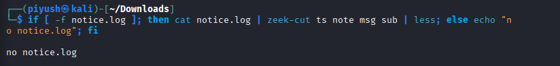
Zeek did not produce a notice.log for this PCAP. This is expected, because Zeek’s default policies focus on protocol anomalies and behavioral events. Exploit-kit–driven infections like Angler often look like normal HTTP traffic, so they don’t trigger default notices.
This demonstrates a key point: ✔ Zeek excels at providing structured metadata ❌ But does not always automatically detect the malware event
So we use conn.log, dns.log, and http.log manually to uncover the infection chain.

Slide 18
Phase 2: Identifying the Victim (The "Who") Knowing Infected Computer (Hostname & MAC Address)
2.1 Filter for DHCP
Goal: Find the Hostname and MAC address of the machine associated with the suspicious IP 192.168.137.85
Wireshark Filter: ip.addr == 192.168.137.85
Evidence:
Hostname: Leonardo-PC
MAC Address: 80:c1:6e:6a:0b:f2

Slide 19
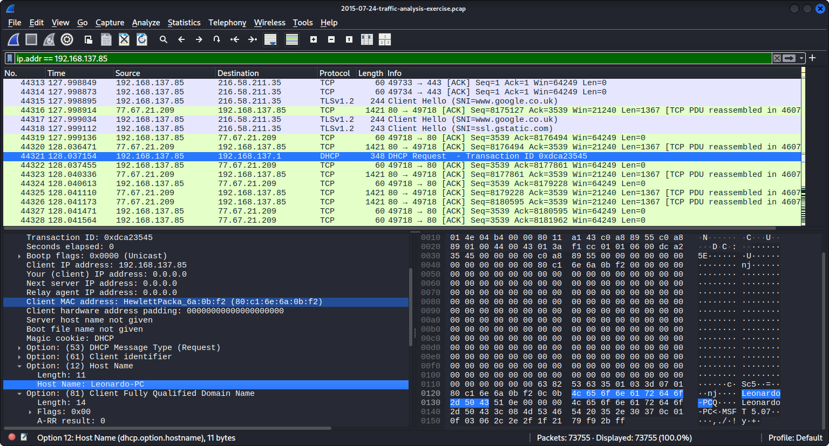
Notes:
Hostname: Leonardo-PC
MAC Address: 80:c1:6e:6a:0b:f2

Slide 20
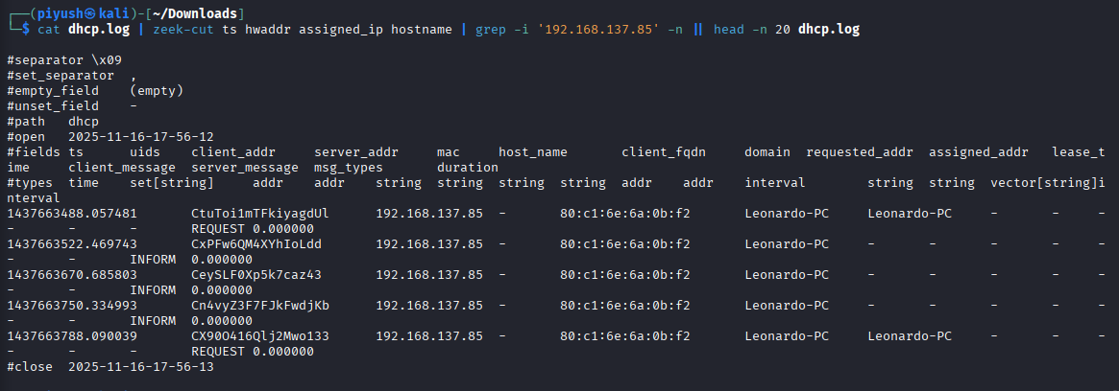
Discover hostname & MAC address via DHCP on Zeek
DHCP shows a hostname and MAC for each client — tie the infected IP to host name (e.g., Leonardo-PC) and MAC.

Slide 21
2.2 User-Agent Analysis (OS & Browser)
Goal: Determine what Operating System and Browser the victim was using.
Wireshark Filter: http.user_agent and ip.src == 192.168.137.85
Evidence
Windows NT 6.1 indicates Windows 7.
Trident/7.0; rv:11.0 indicates Internet Explorer 11.

Slide 22
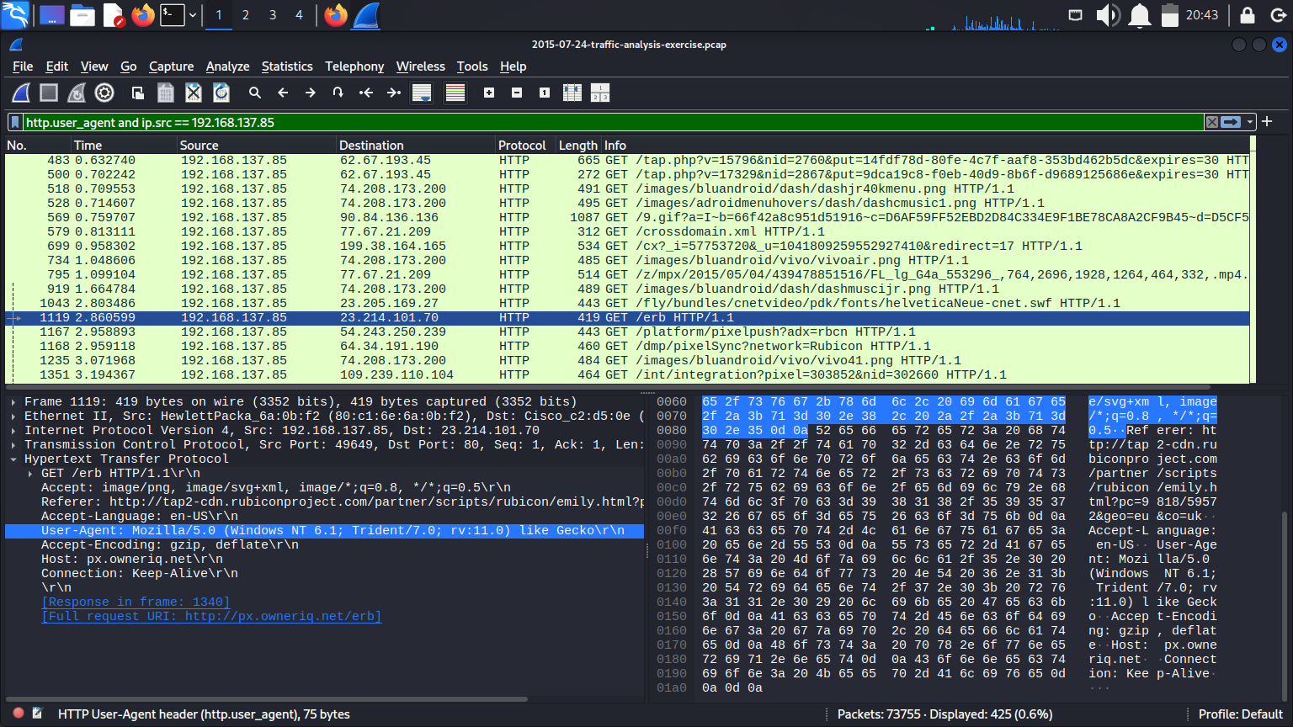
Notes:
OS and Browser: Windows 7 and Internet Explorer 11

Slide 23
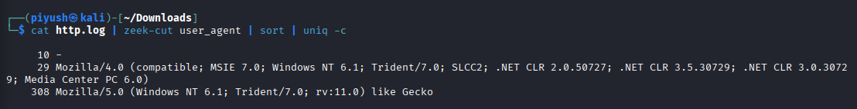
Clear view of OS/Browser
Commands:
# Look for user-agent strings in http.log
cat http.log | zeek-cut user_agent | sort | uniq -c
This shows:
Windows 7 (NT 6.1)
IE 11 (rv:11.0)
Notes:
8D

Slide 24
Phase 3: Finding the Infection Vector (The "How")
Goal: Find where the bad traffic started.
Action: Look for the transition from "normal surfing" to "malicious redirection."

Slide 25
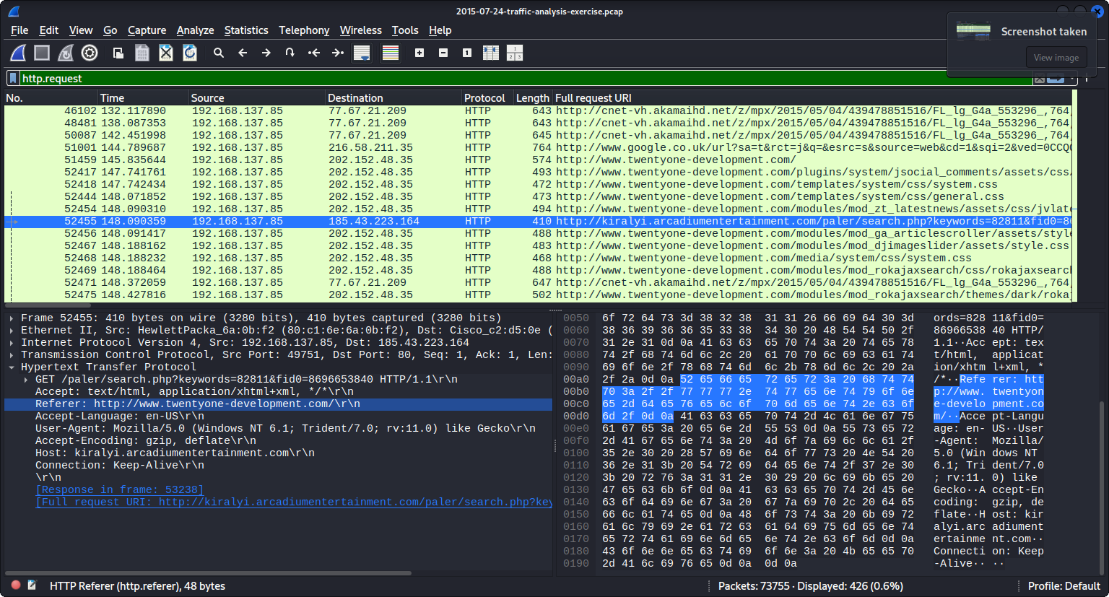

Slide 26
There is a visit to twentyone-development.com, followed immediately by a strange domain (kiralyi.arcadiumentertainment.com).
Packet 52454: Request to twentyone-development.com (Normal site).
Packet 52455 (Highlighted): Request to kiralyi.arcadiumentertainment.com (Malicious site).
The Link (Referer): In the bottom pane, the highlighted line Referer: http://www.twentyone-development.com/ proves that the normal site pushed the user to the malicious one.
Malicious Ip Address: 185.43.223.164

Slide 27
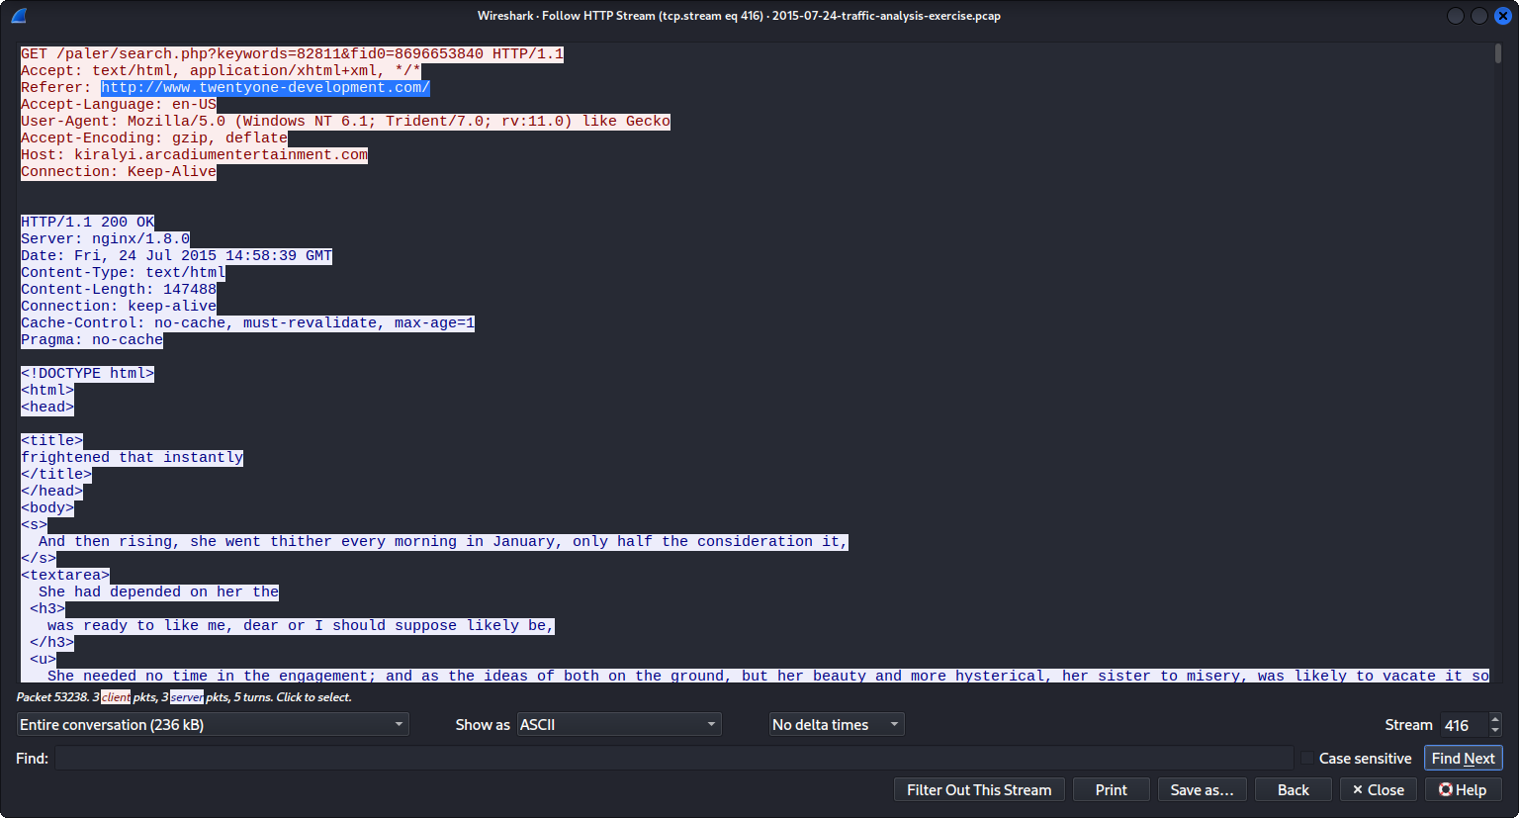
Notes:
The TCP Stream window showing the GET request to the Exploit Kit

Slide 28
Finding the Infection Vector (The "How") on Zeek
At first, the http.log was flooded with requests,a classic sign of exploit kit activity. To cut through the noise, we
filtered step by step: starting with domains, then narrowing to suspicious URIs, and finally tracing the referer chain.
As the clutter cleared, a pattern emerged — a legitimate website redirecting to an Angler Exploit Kit landing page.
Moments later, we spotted the Flash exploit request, confirming the infection path.

Slide 29
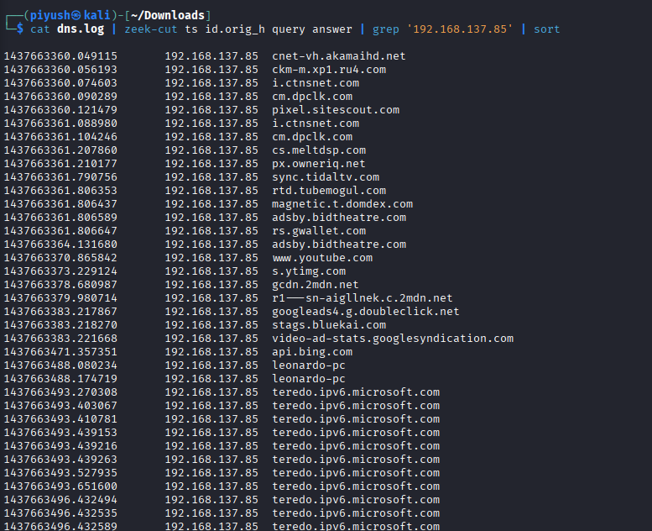
Normal HTTP requests
Notes:
DNS queries

Slide 30
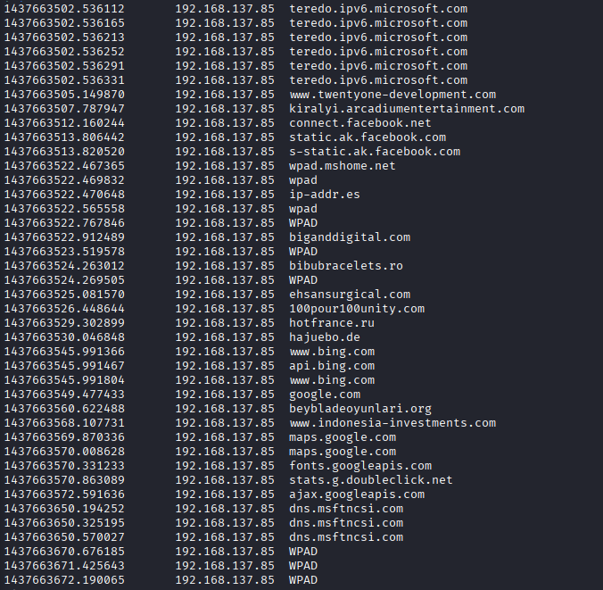
HTTP Referer Chain (Critical Evidence): twentyone-development.com → kiralyi.arcadiumentertainment.com

Slide 31
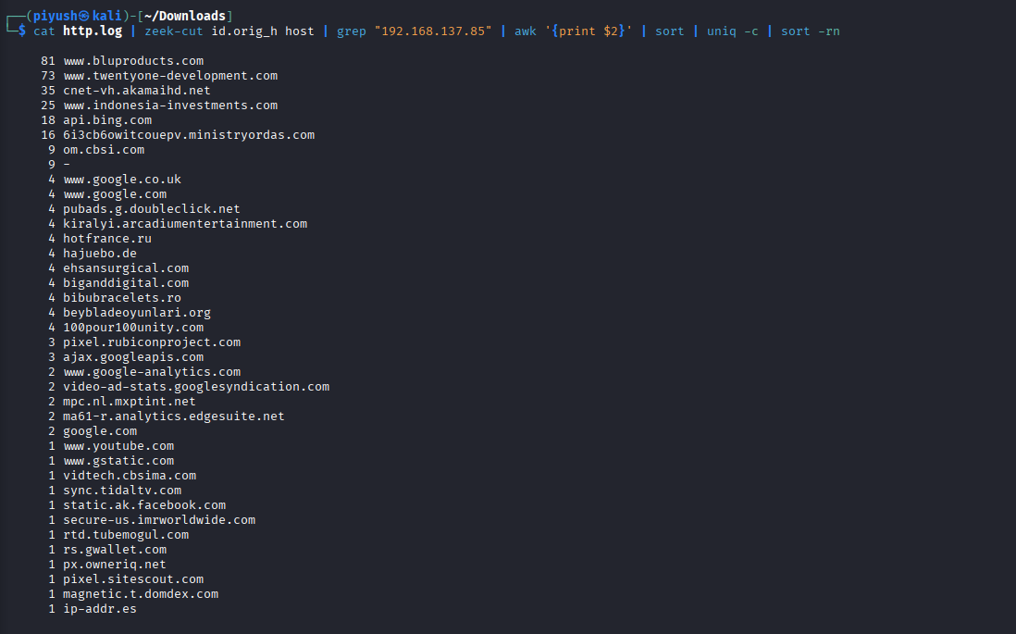
A clean table of domains the infected host contacted WITHOUT URLs, user-agent, referrer, etc.
www.twentyone-development.com ← compromised site
kiralyi.arcadiumentertainment.com ← Angler Exploit Kit
Notes:
8A A clean table of domains the infected host contacted WITHOUT URLs, user-agent, referrer, etc.
www.twentyone-development.com ← compromised site
kiralyi.arcadiumentertainment.com ← Angler Exploit Kit

Slide 32
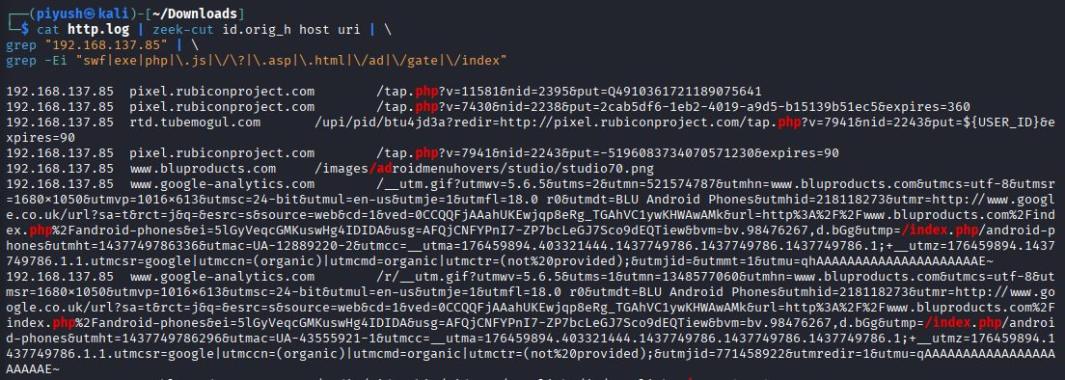
Show only suspicious or uncommon domains
Only URIs related to:
exploits (.swf)
payloads (.exe)
redirect code
command & control gateways
Notes:
8B Show only suspicious or uncommon domains
Only URIs related to:
exploits (.swf)
payloads (.exe)
redirect code
command & control gateways

Slide 33
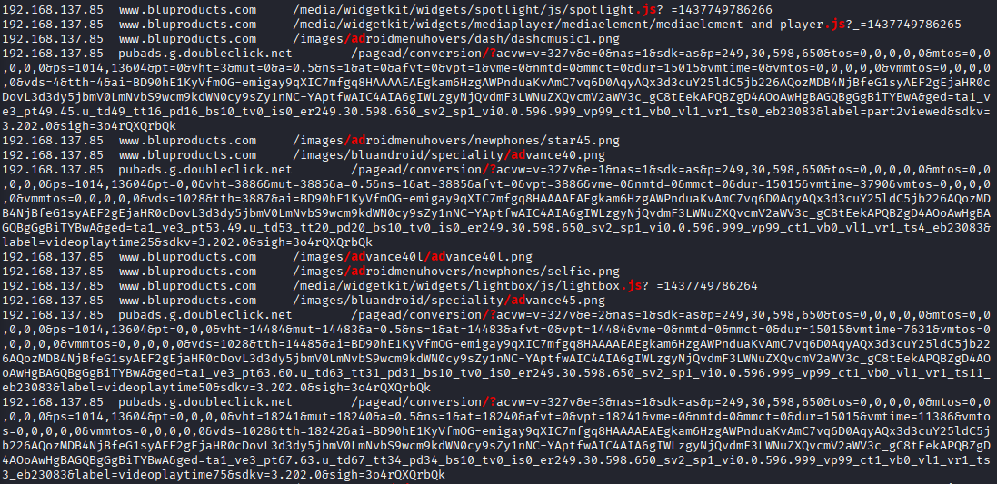

Slide 34
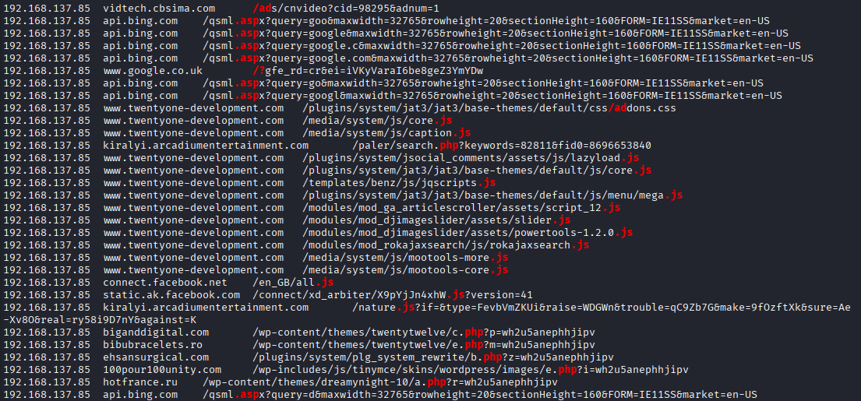

Slide 35
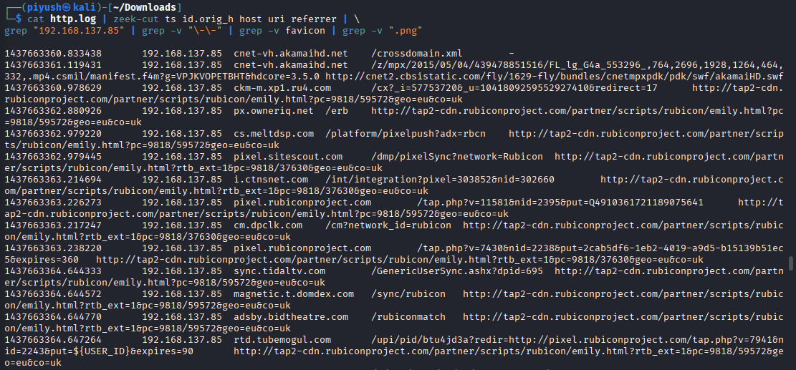
Referrer chain
Notes:
Referrer chain

Slide 36
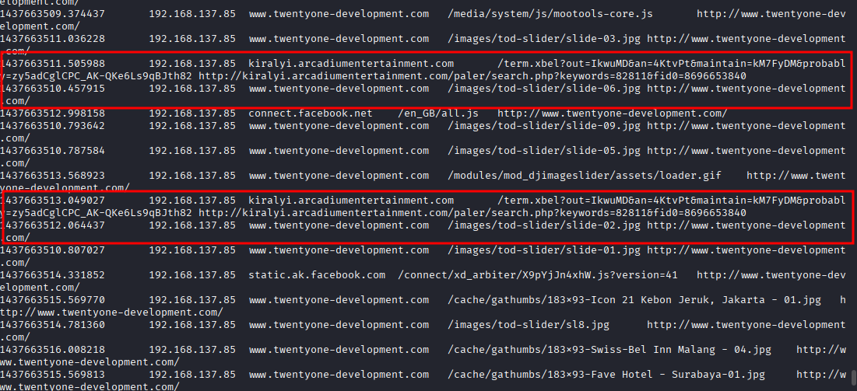
This is the infection pivot.
Here we confirm the exploit kit in use:
kiralyi.arcadiumentertainment.com resolves to 185.43.223.164.
This domain is associated with the Angler Exploit Kit, active in 2015.
Notes:
1437663512.064636 192.168.137.85 www.twentyone-development.com /images/tod-slider/slide-10.jpg http://www.twentyone-development.com/
1437663516.850482 192.168.137.85 www.twentyone-development.com /images/project-gallery/...jpg http://www.twentyone-development.com/
1437663516.871982 192.168.137.85 kiralyi.arcadiumentertainment.com /nature.js?... -
1437663522.766477 192.168.137.85 ip-addr.es / -

Slide 37
Infection Flow Revealed by HTTP Referer Chain
1️⃣ Legitimate Website
www.twentyone-development.com User visits a normal business site that has been compromised.
2️⃣ Redirect to Exploit Kit
kiralyi.arcadiumentertainment.com Browser is silently redirected to Angler Exploit Kit, loading nature.js.
3️⃣ Post-Infection Callback
ip-addr.es CryptoWall checks the victim’s public IP, confirming successful infection.

Slide 38
Phase 4: The Exploit & Payload (The "What")
Goal: We need to see exactly what the bad guy sent to the victim. In this case, we want to see the Exploit Kit delivering its weapon.
Action: Analyze the traffic exchanged with the suspicious Ip 185.43.223.164
The network traffic between the infected host (192.168.137.85) and the exploit kit server (185.43.223.164) was isolated for detailed inspection. This step was performed using Wireshark to visualize the exact payload sent by the attacker. By following the TCP stream, the exploit content — a malicious JavaScript file (nature.js) delivered by the Angler Exploit Kit — was identified and confirmed as the weapon used in the infection.

Slide 39
4.1 Filter by Malicious IP:
Filter for the Attacker's IP
ip.addr == 185.43.223.164 && http.response.code == 200
Analysis: Look at the content types. It shows application/x-shockwave-flash. This confirms a Flash exploit was sent.
Notes:
Filter : ip.addr == 185.43.223.164 && http.response.code == 200

Slide 40
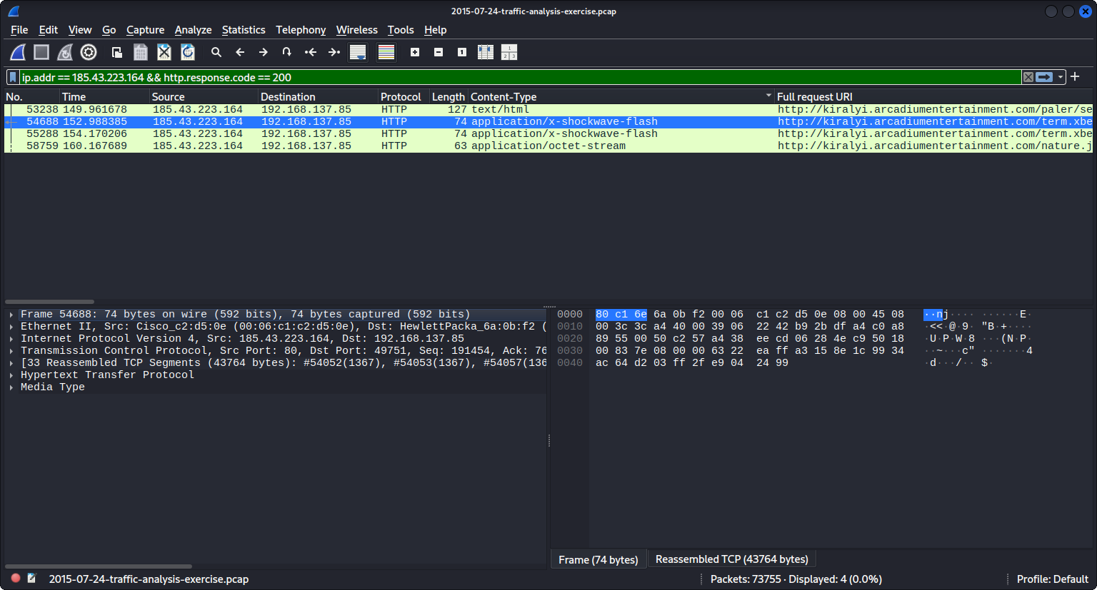
Notes:
Traffic between the victim and the Angler Exploit Kit IP (185.43.223.164), showing the download of malicious Flash files

Slide 41
4.2 Analyze the Traffic
The presence of application/x-shockwave-flash confirms that the Angler Exploit Kit is trying to exploit a vulnerability in Adobe Flash Player. This was the most common way computers got infected back in 2015.
This screenshot captures the exact moment the Angler Exploit Kit pushed its payload onto the victim's machine.
application/x-shockwave-flash: This is the exploit. Angler EK (the kit used here) was famous for using vulnerabilities in Adobe Flash to break into systems.
application/octet-stream: This is likely the payload (the actual malware) being downloaded in an encrypted or obfuscated format to bypass antivirus.

Slide 42
The Exploits (The "Keys") Packets containing application/x-shockwave-flash are the exploits. The Angler Exploit Kit detected an outdated Adobe Flash Player and sent a crafted Flash file to exploit it — like a burglar picking the lock.
The Payload (The "Bomb") A packet with application/octet-stream delivers the encrypted malware payload — the “bomb.” Based on the 2015 capture and Angler EK activity, this is most likely CryptoWall 3.0 ransomware.

Slide 43
Phase 5: Post-Infection Traffic (The "Aftermath")
We’ve observed the malware entering the system — now we need to confirm if it actually executed. If the exploit was successful, the infected host should immediately “phone home” to a Command and Control (C2) server.
Goal: Confirm that the malware ran and established C2 communication. Action: Analyze post-exploit traffic for connections to new or suspicious external destinations.

Slide 44
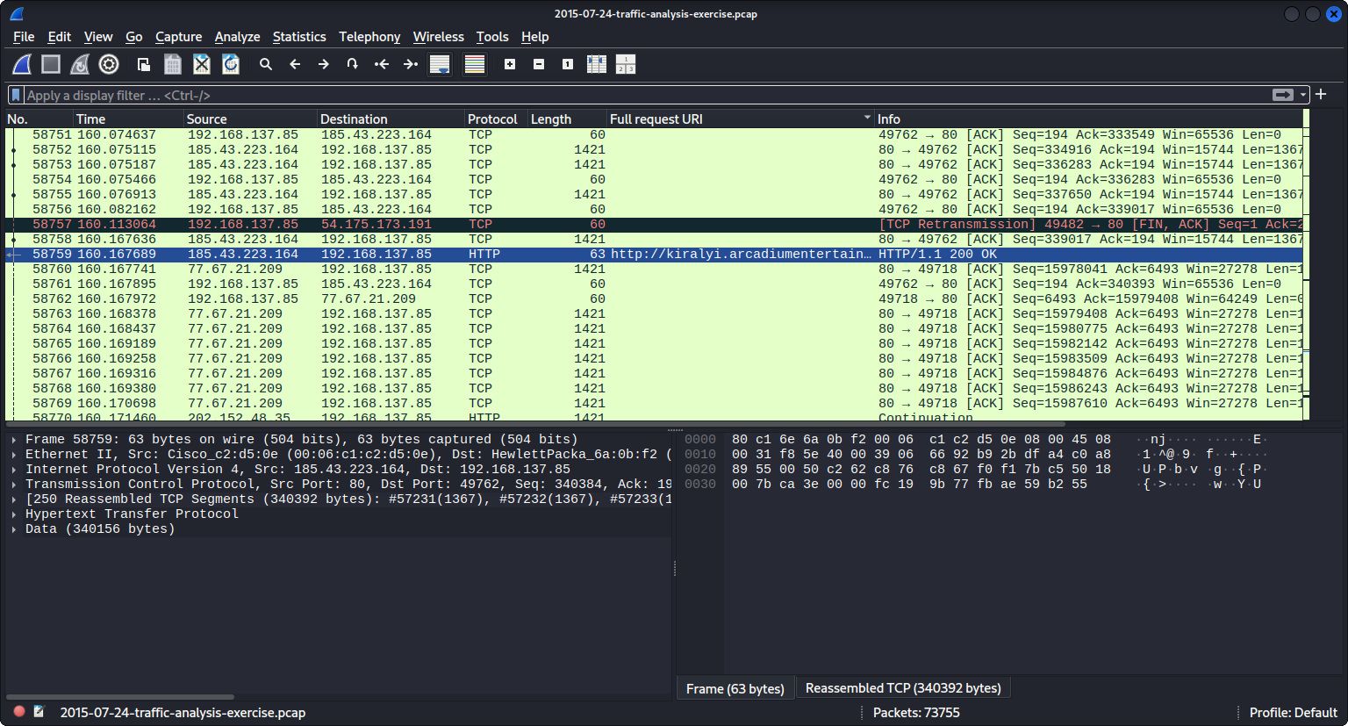
Packet 58759 (Highlighted): This HTTP 200 OK is the completion of the malware download. The "bomb" has officially entered the building.
Notes:
Go to Packet 58759 (where the payload was downloaded) and look at the traffic immediately after it.

Slide 45
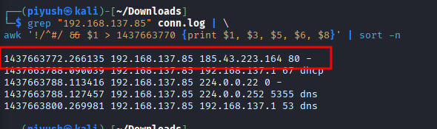
Post-Infection Connections
We inspected conn.log for all outbound traffic after the exploit timestamp. Zeek confirmed the connection to the Angler Exploit Kit server (185.43.223.164), which is the key malicious external host.
Subsequent entries were only normal LAN activity (DNS, DHCP, multicast). CryptoWall C2 activity appears only in http.log for this PCAP, which is typical for short-lived HTTP callbacks.
Notes:
Step 17

Slide 46
5.1 Find the "Call Home" (C2) Traffic
Now that the malware is on the computer, it has to unzip itself, install, and then contact the attacker's server to say, "I'm active!" (This is called Command and Control, or C2).
Filter: http.request
Identify the Pattern:
You will see the victim (192.168.137.85) suddenly reaching out to a bunch of random-looking domains that they haven't visited before.
ip-addr.es (This is the malware checking "What is my public IP?")

Slide 47
5.2 Find the "Final" Confirmation

Slide 48
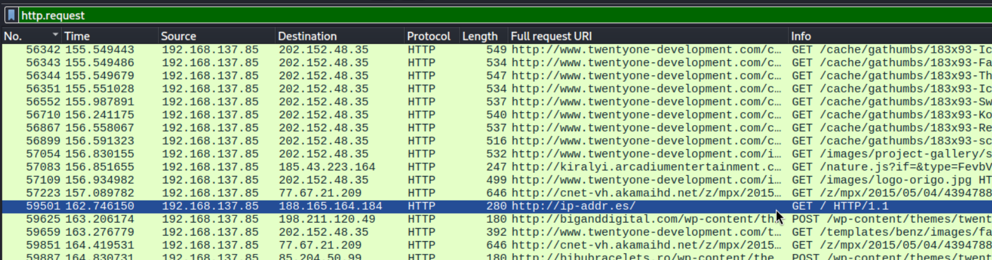
5.2.1 The Ip Check (Packet 59501)

Slide 49
You can see a request to 188.165.164.184.
This corresponds to ip-addr.es.
Significance: Malware often checks the infected machine's public IP address to register it with the attacker's database.

Slide 50
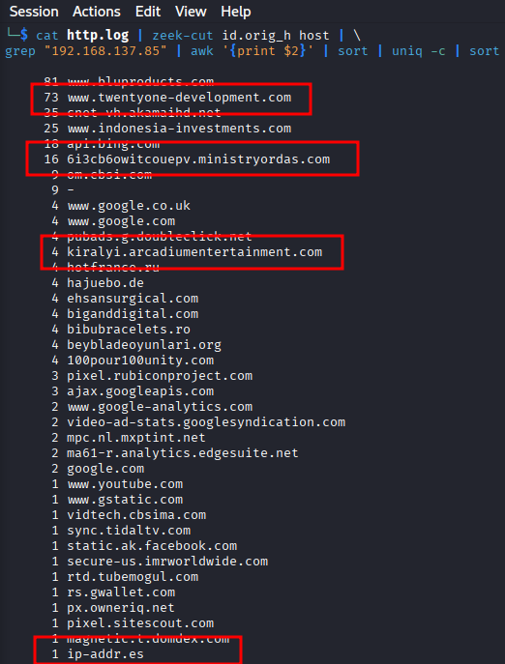
Malicious IP Extraction
73 www.twentyone-development.com ← Landing site (legit but compromised)
16 6i3cb6owitcouepv.ministryordas.com ← CryptoWall ransom page
4 kiralyi.arcadiumentertainment.com ← Angler Exploit Kit
1 ip-addr.es ← CryptoWall callback

Slide 51
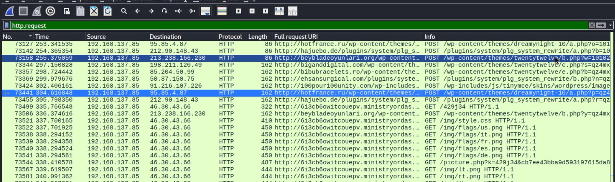
5.2.2 The C2 Callbacks (Packets 73158 and others):
See those lines that say POST in the Info column?
Packet 59625: POST to biganddigital.com
Packet 60000: POST to ehsansurgical.com
Packet 60311: POST to 100pour100unity.com
This is the malware "phoning home." It is trying to connect to different compromised websites to signal that the infection was successful.

Slide 52
Traffic to 95.85.4.87 (hotfrance.ru).
Traffic to 213.238.166.230 (beybladeoyunlari.org).
Significance: These are the Command & Control servers. The malware is saying, "I'm here, I've encrypted the files, waiting for instructions."

Slide 53
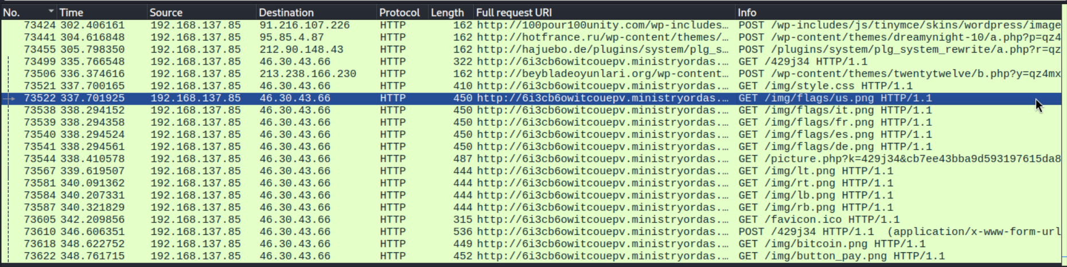
5.2.3. The "Ransom Note" Indicators (Packets 73522 - 73622)

Slide 54
Traffic to 46.30.43.66. This corresponds to the domain 6i3cb6owitcouepv.ministryordas.com.
Significance: This is likely the page the user is forced to visit to see the "Decrypt Instructions" and pay the ransom.
/img/flags/us.png
/img/flags/de.png
/img/bitcoin.png (Packet 73618)
/img/button_pay.png (Packet 73622)
These files are the graphics used to build the Ransom Note web page that pops up on the victim's screen, demanding payment in Bitcoin. This is definitive proof that the payload was Ransomware.

Slide 55
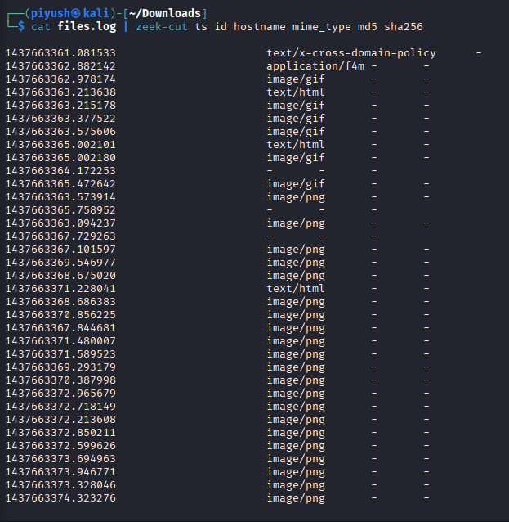
Using Zeek’s http.log, we observed multiple image requests to ministryordas.com — including /img/flags/us.png, /img/flags/de.png, /img/bitcoin.png, and /img/button_pay.png. These resources form the ransom note displayed to the victim, confirming that the executed payload was CryptoWall ransomware.
Notes:
Opening the PCAP file

Slide 56
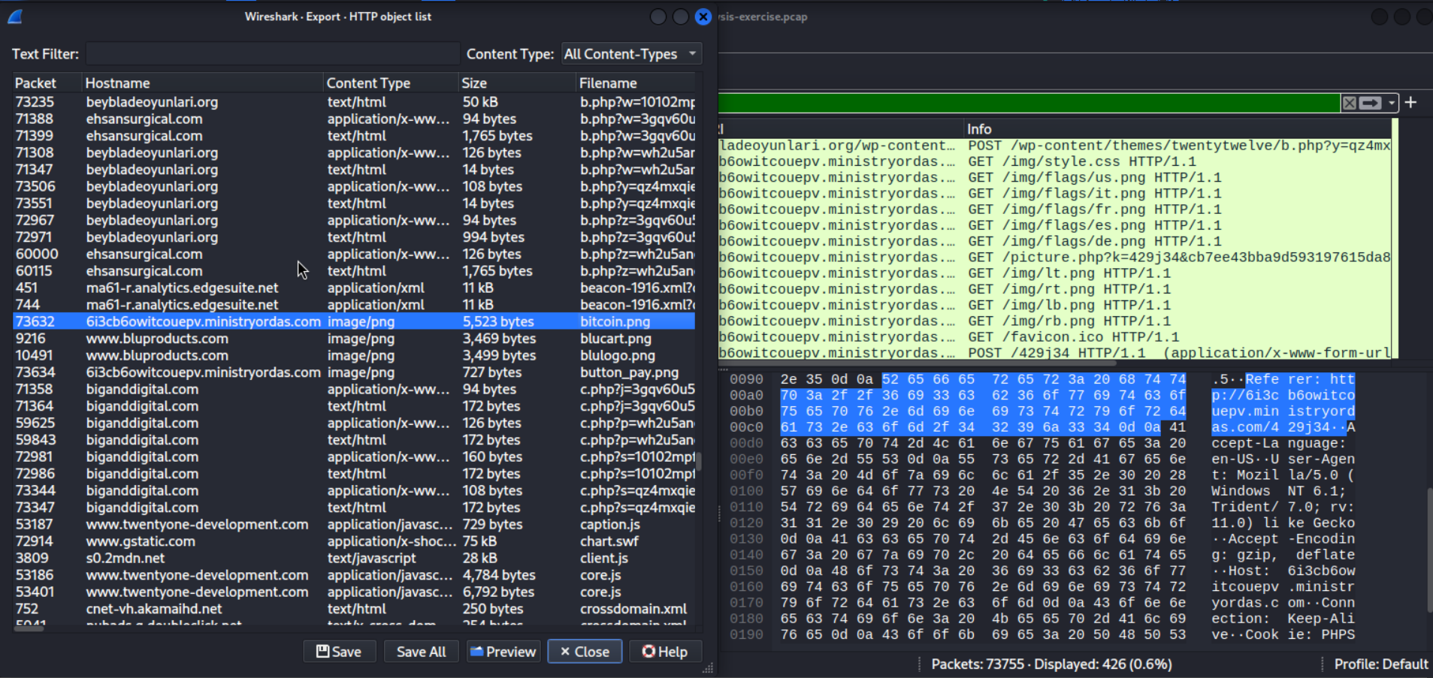
Artifact Extraction & Verification

Slide 57

Recovered visual assets used in the ransomware payment portal.
Method: Extracted bitcoin.png directly from unencrypted HTTP traffic (Packet 73618).
Significance: The presence of this image confirms the final payload was CryptoWall 3.0 (Ransomware).

Slide 58
Time (UTC) | Event
14:58:32 | User visits twentyone-development.com
14:58:36 | Silent redirect → kiralyi.arcadiumentertainment.com
14:58:37 | Malicious exploit JS (nature.js) delivered
14:58:45 | CryptoWall callback to ip-addr.es
14:59+ | Ransom note assets loaded from ministryordas.com

Slide 59
Summary
Victim ID: Leonardo-PC / 80:c1:6e:6a:0b:f2 (via DHCP).
Environment: Windows 7 / IE 11 (via User-Agent).
Infection Vector: Compromised site twentyone-development.com redirected via Referer header to the Exploit Kit.
The Weapon: Angler Exploit Kit at 185.43.223.164 delivered a Flash exploit (application/x-shockwave-flash).
The Impact: CryptoWall 3.0 infection confirmed by C2 traffic to ip-addr.es, hotfrance.ru, and ministryordas.com.

Slide 60
Summary of the attack chain
Tracking the entire lifecycle of this infection.
The Trap: The user visited the compromised site twentyone-development.com.
The Redirection: The site silently redirected the user to the Angler Exploit Kit at kiralyi.arcadiumentertainment.com (185.43.223.164).
The Exploit: The kit sent a malicious Flash file (application/x-shockwave-flash) that exploited a vulnerability in the user's browser.
The Payload: The exploit downloaded the ransomware payload (application/octet-stream).
The Damage: The ransomware installed itself and phoned home to 46.30.43.66 (CryptoWall C2) to confirm the infection and prepare the ransom payment page.

Slide 61
Notes:
Top talker

Slide 62
Zeek vs Wireshark Strengths
Zeek Strengths:
Fast metadata analysis
Clear logs (DNS, HTTP, conn)
Great for domain & timeline reconstruction
Wireshark Strengths:
Full packet content
Payload extraction
Visual protocol analysis
Both tools complemented each other and revealed the same infection story.

